Slide 1

  BLESSINO PHARMACY INSTITUTE
PERSEVERANCE CONQUERS
  ALL
PCI APPROVED INSTITUTION FOR DIPLOMA IN PHARMACY (D.PHARM)

Slide 2

  TABLE OF CONTENTS
  01
  02
  03
  04
05
06
INTRODUCTION
WHY CHOOSE BLESSINO?
  OUR MISSION AND VISION
  OUR PROGRAMS
FEE STRUCTURE
OUR FACULTY
  1

Slide 3
INTRODUCTION:
Blessino Pharmacy Institute is established in the year 2024 by Blessino Welfare Society under the chairmanship of Dr. C.Vanneihthanga with the main objectives of bringing the youth together, to educate and produce the best in pharmacy field. It also aims to meet the health needs of the society. Only diploma course is offered for now and it is yet to be upgraded.
MOTTO: Perseverance conquers all.
PHILOSOPHY:
Pharmacy is the science and art of preparing, dispensing, and properly utilizing medications to promote the health and well-being of individuals and communities. At the heart of our approach is a deep commitment to improving patient outcomes, enhancing quality of life, and advancing the role of the pharmacist in the healthcare team.
  2

Slide 4
Our philosophy is grounded in the following principles :
Patient-Centered Care: We believe that effective pharmacy practice is built on the foundation of compassionate, personalized care. Every patient is unique, and their treatment should be tailored to their individual needs, preferences, and health conditions. Pharmacists act as trusted healthcare providers, offering advice on medication management, safety, and therapy optimization.
Knowledge and Excellence: We are committed to continuously advancing our understanding of pharmacology, drug therapy, and healthcare innovations. This commitment enables us to provide expert guidance and evidence-based solutions in a rapidly evolving field.
Collaboration and Teamwork: Pharmacy practice is an integral part of a larger healthcare team, and effective collaboration with physicians, nurses, and other healthcare professionals is essential for providing comprehensive care. We strive to foster strong partnerships within the healthcare system to improve patient outcomes.
  3

Slide 5
Ethical Responsibility: Pharmacists uphold the highest standards of integrity and professionalism. Our practice is guided by ethical principles, ensuring that patients’ safety, privacy, and well-being remain our top priorities. We advocate for responsible use of medications and strive to minimize the risk of harm.
Innovation and Research: The field of pharmacy is dynamic and ever-changing. We believe in the importance of innovation in medication therapy management, drug development, and patient care practices. Pharmacists contribute to advancing healthcare by engaging in research and staying at the forefront of pharmaceutical sciences.
Lifelong Learning: Continuous education and self-improvement are vital to providing the best possible care. As healthcare landscapes evolve, we remain dedicated to learning, adapting, and applying new knowledge to meet the needs of patients and society.
By embodying these principles, our goal is to cultivate a new generation of pharmacy professionals who are equipped not only with the technical expertise but also with the compassion and commitment to making a meaningful difference in the lives of those they serve.
  4

Slide 6
APPLICATION PROCEDURE:
60 candidates shall be admitted to the course every year.
ELIGIBILITY:
Class XII Science Passed
SUBJECTS OFFERED:
1st Year
Pharmaceutics
Pharmaceutical Chemistry
Pharmacognosy
Human Anatomy and Physiology
Social Pharmacy
2Nd Year:
Pharmacology
Community Pharmacy & Management
Biochemistry and Clinical Pathology
Pharmacotherapeutics
Hospital and Clinical Pharmacy
Pharmacy Law & Ethics
  5

Slide 7
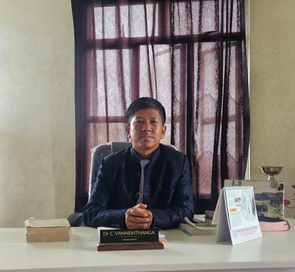
  WHY CHOOSE BLESSINO PHARMACY INSTITUTE?
DIRECTOR'S MESSAGE
"Welcome to Blessino Pharmacy Institute, where we are dedicated to shaping the future of pharmacy professionals. Our institution is committed to providing high-quality education, innovative research opportunities, and a supportive learning environment.
Our Mission
At Blessino Pharmacy Institute, our mission is to empower students with the knowledge, skills, and values necessary to excel in the dynamic field of pharmacy. We strive to foster a culture of excellence, innovation, and community engagement.
Our Commitment
We are committed to:
- Providing cutting-edge education and training
- Encouraging research and innovation
- Fostering a supportive and inclusive community
- Preparing students for successful careers in pharmacy
Dr. VANNEIHTHANGA
Director
  Blessino Welfare Society
  6

Slide 8
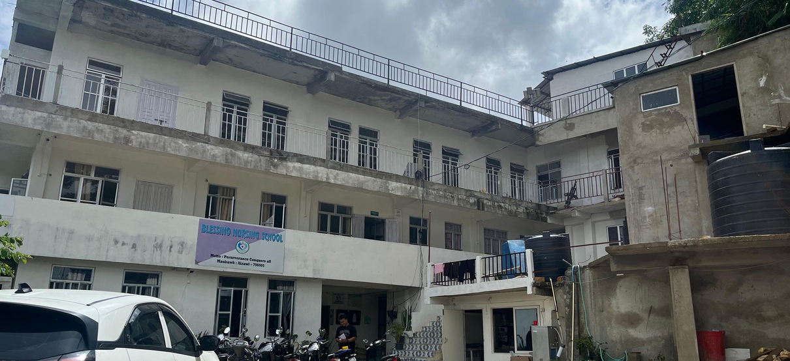
  OUR MISSION AND VISION
  WE TRAIN OUR STUDENTS TO REACH THEIR MAXIMUM POTENTIAL.
Academic Excellence
At Blessino Pharmacy Institute, we prioritize academic excellence through:
- Rigorous academic programs
- Experienced faculty
- State-of-the-art facilities
Student-Centric Approach
We prioritize student success through:
- Personalized support
- Mentorship
- Opportunities for growth and development
Community Engagement
We believe in fostering strong connections with:
- Healthcare industry partners
- Community organizations
  - Alumni network
PRINCIPAL'S MESSAGE
  "As Principal of Blessino Pharmacy Institute, I am proud to lead an institution that is dedicated to academic excellence, innovation, and student success. Our institute is a vibrant community of learners, educators, and professionals who share a passion for pharmacy and healthcare..”
  7

Slide 9
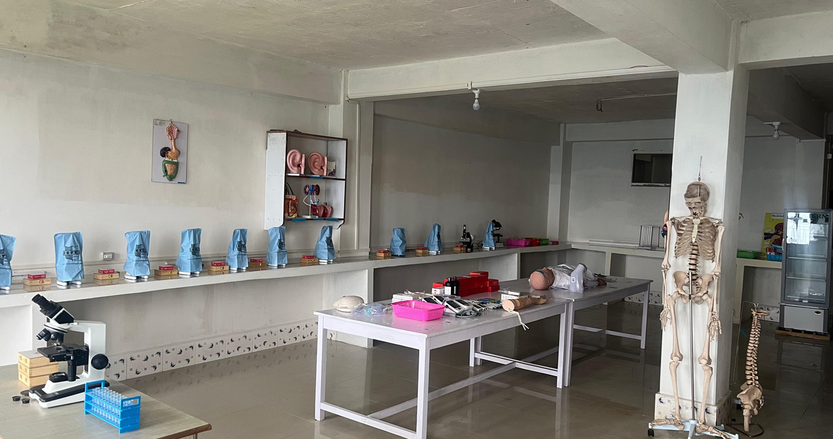
  OUR PROGRAM
DIPLOMA IN PHARMACY
  (D.PHARM)
  2 years course
  Recognized by Pharmacy Council of India (PCI)
  Affiliated to Higher & Technical Education, Govt of Mizoram
  8

Slide 10
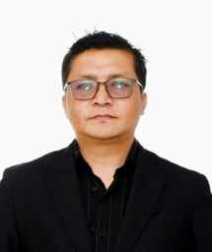
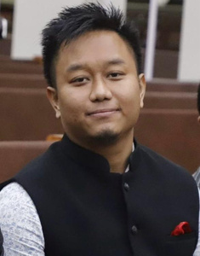
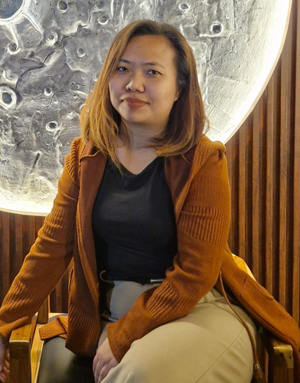
  OUR FACULTY
  Dr. ZOTHANMAWIA CHERPUT
  Principal
Doctor of Pharmacy
  (PharmD)
  Dr. SAIDINGLIANA SAILO
  Lecturer
Doctor of Pharmacy
  (PharmD)
  Ms. LALNUNHRUAITLUANGI
  Lecturer
Ph.D Scholar (RIPANS)
Master of Pharmacy
  (Pharmaceutical Chemistry)
  9

Slide 11
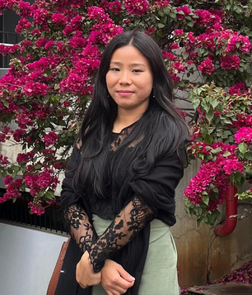
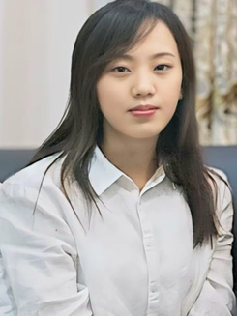
  OUR FACULTY
  Ms. NGURZAMPUII SAILO
  Lecturer
Ph.D Scholar (Dibrugarh University)
Master of Pharmacy
  (Pharmacognosy and Phytochemistry)
  Ms. ZONUNTLUANGI
  Lecturer
Ph.D Scholar (RIPANS)
Master of Pharmacy
(Pharmaceutics)
  10

Slide 12
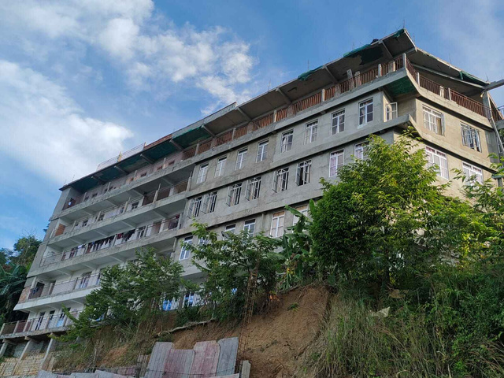
  BLESSINO PHARMACY INSTITUTE
  CONTACT US
Maubawk Aizawl Mizoram
9774034096/8794090630/8257889490
www.blessino.com
email: blessinopharmacy@gmail.com
  11

